Slide 1
Chapter IV
Spaces and Transforms

Slide 2

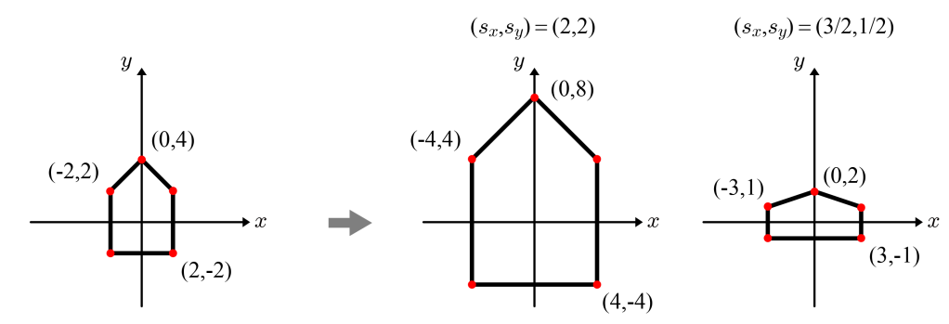
Scaling
2D scaling with the scaling factors, s_{x} and s_{y}
Examples
When a polygon is scaled, all of its vertices are processed by the same scaling matrix.
4-<number>

Slide 3



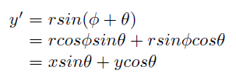

Rotation
2D rotation
4-<number>

Slide 4


Rotation (cont’d)
By default, the rotation is counter-clockwise.
The matrix for the clockwise rotation by θ is obtained by inserting -θ into the 2D rotation matrix.
Note that rotation by -θ is equivalent to rotation by 2π-θ.
4-<number>

Slide 5



Translation and Homogeneous Coordinates
Translation is represented as vector addition.
Fortunately, we can describe translation as matrix multiplication if we use the homogeneous coordinates.
  Homogeneous coordinates for the point to be translated: (x,y) → (x,y,1)
  Translation matrix
Matrix-point multiplication
(d_{x}, d_{y})
(x+d_{x}, y+d_{y})
(x, y)
4-<number>

Slide 6
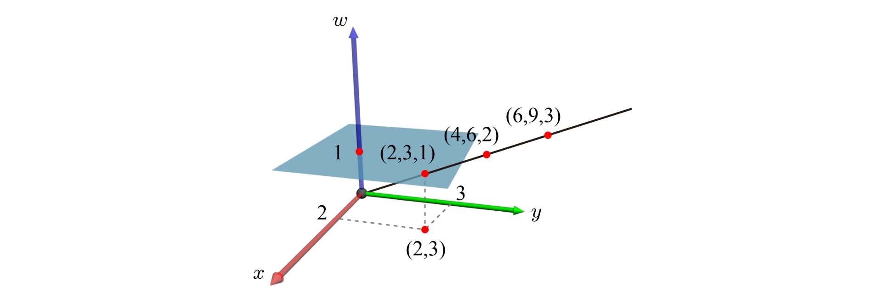
Translation and Homogeneous Coordinates (cont’d)
For a point, the fourth component of the homogeneous coordinates is not necessarily 1 and is denoted by w.
Cartesian coordinates (x, y) are converted into homogeneous coordinates (wx, wy, w) with non-zero w. For example, the Cartesian coordinates (2,3) can be converted into multiple homogeneous coordinates, (2,3,1), (4,6,2), (6,9,3), etc.
The line connecting (2, 3, 1) and the origin represents infinitely many points in homogeneous coordinates. Given the homogeneous coordinates (X, Y, w), the corresponding Cartesian coordinates are (X/w, Y/w). It is often described as projecting a point on the line onto the plane.
4-<number>

Slide 7




Translation and Homogeneous Coordinates (cont’d)
For handling the homogeneous coordinates, the 3x3 matrices for scaling and rotation need to be altered.
4-<number>

Slide 8
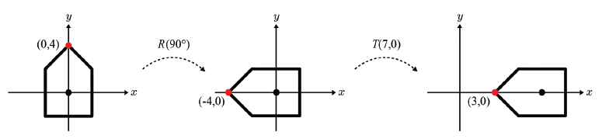






Transform Composition
An object may go through multiple transforms.
4-<number>

Slide 9
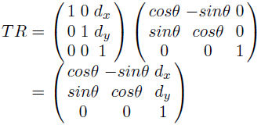
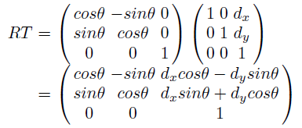
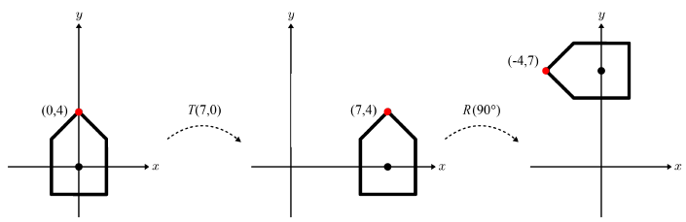
Transform Composition (cont’d)
Matrix multiplication is not commutative.
Rotation (R) followed by translation (T) vs. T followed by R
4-<number>

Slide 10
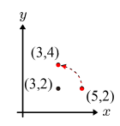

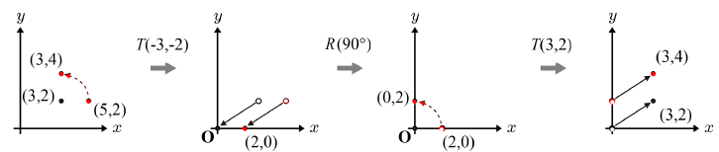
Transform Composition (cont’d)
So far, rotations are about the origin. Let us now consider rotation about an arbitrary point, which is not the origin.
Example: rotation of (5,2) about (3,2)
Rotating a point at (x,y) about an arbitrary point, (a,b)
  Translating (x,y) by (-a,-b)
  Rotating the translated point about the origin
  Back-translating the rotated point by (a,b)
4-<number>

Slide 11





Transform Composition (cont’d)
4-<number>

Slide 12
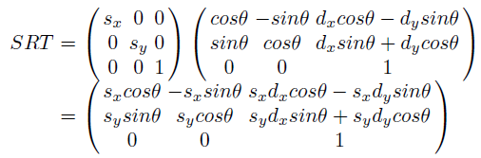
Affine Transform
Affine transform
  Linear transform
    Scaling (S)
    Rotation (R)
  Translation (T)
No matter how many affine matrices are given, they can be combined into a matrix.
When a series of affine transforms is concatenated to make a single 3x3 matrix, the third row is always (0 0 1).
4-<number>

Slide 13
Affine Transform (cont’d)
  Ignoring the third row of an affine matrix, we often denote the remaining 2x3 elements by [L|t], where L is a 2x2 matrix and t is a 2D column vector.
    L represents a ‘combined’ linear transform, which does not include any terms from the input translations.
    In contrast, t represents a ‘combined’ translation, which may contain the input linear-transform terms.
4-<number>

Slide 14
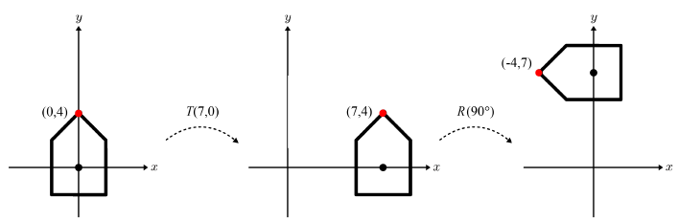
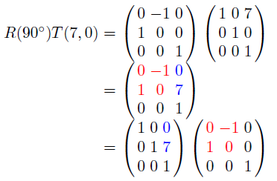
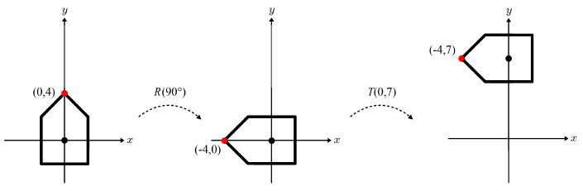
Affine Transform (cont’d)
  Transforming an object by [L|t] is conceptually decomposed into two steps: L is applied first and then the linearly transformed object is translated by t.
4-<number>

Slide 15
Rigid Motion
  Consider a combination of rotations and translations only, i.e., no scaling is involved.
    When the combined affine matrix applies to an object, the pose of the object is changed but its shape is not.
    In this sense, the transform is named rigid-body motion or simply rigid motion.
  No matter how many rotations and translations are combined, the resulting matrix is of the structure, [R|t], where R represents the ‘combined’ rotation, which does not include any translation terms, and t represents the ‘combined’ translation, which usually includes the rotation terms.
  Transforming an object by [R|t] is conceptually decomposed into two steps: R is applied first and then the rotated object is translated by t .
4-<number>

Slide 16
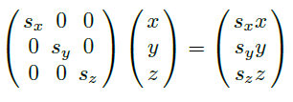
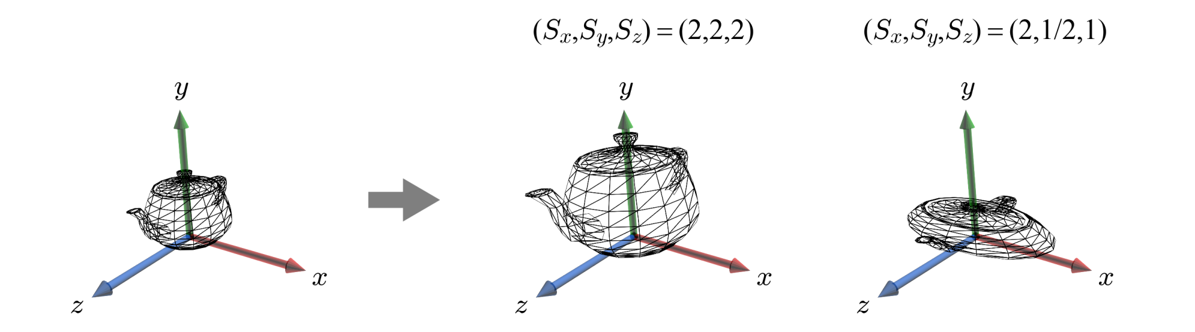
3D Scaling
3D scaling
If all of the scaling factors are identical, the scaling is called uniform. Otherwise, it is a non-uniform scaling.
4-<number>

Slide 17
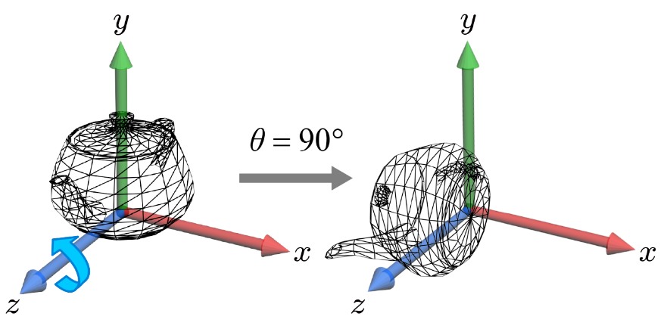
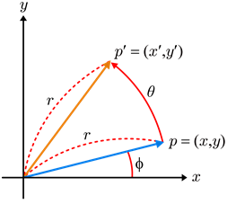

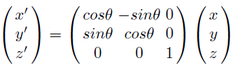


3D Rotation
Unlike 2D rotation which requires a center of rotation, 3D rotation requires an axis of rotation.
Let’s consider 3D rotations about x-axis (R_{x}), y-axis (R_{y}), and z-axis (R_{z})
First of all, R_{z}.
(x',y',z')
(x,y,z)
4-<number>

Slide 18
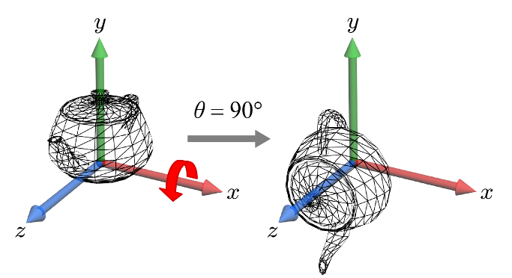
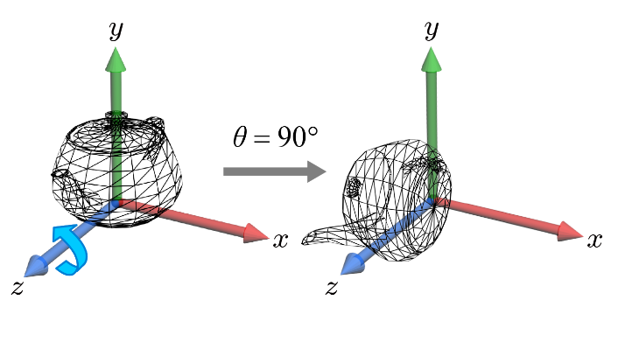
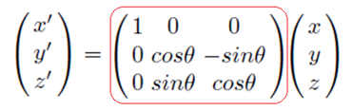
3D Rotation (cont’d)
Observation for R_{x}.
  Obviously, x'=x.
  When the thumb of the right hand is aligned with the rotation axis, the other fingers curl from the y-axis to the z-axis.
  Returning to R_{z}, observe the fingers curl from the x-axis to the y-axis.
  Shifting from R_{z} to R_{x}, the x-axis is replaced with the y-axis, and the y-axis is replaced with the z-axis.
  By making such replacements, the matrix for R_{x} is obtained.
y'
y
z
z'
y
z
R_{x} R_{z}
4-<number>

Slide 19
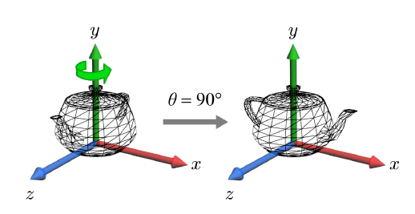
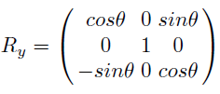
3D Rotation (cont’d)
  In the same manner, we can define the matrix for R_{y}.
4-<number>

Slide 20
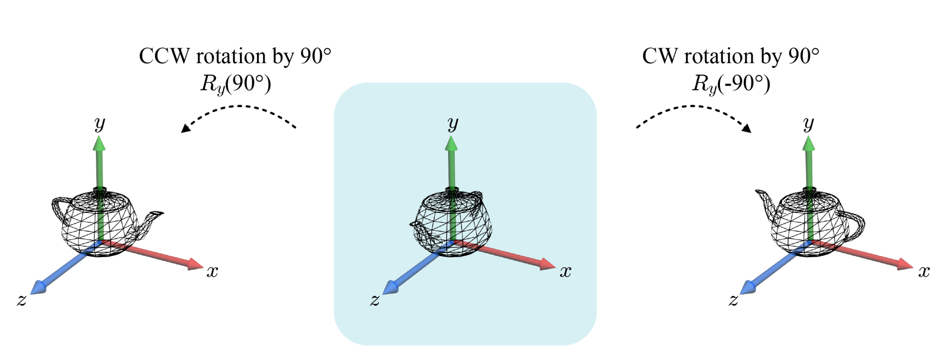
3D Rotation (cont’d)
  CCW vs. CW rotations
    If the rotation is CCW with respect to the axis pointing toward you, the rotation angle is positive.
    If the rotation is CW, its matrix is defined with the negated rotation angle.
Note that rotation by -θ is equivalent to rotation by 2π-θ.
4-<number>

Slide 21
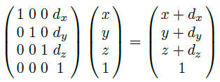
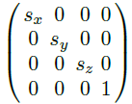
3D Translation
  Matrix-point multiplication
  The 3x3 matrices developed for 3D scaling and rotation are extended to 4x4 matrices.
4-<number>

Slide 22
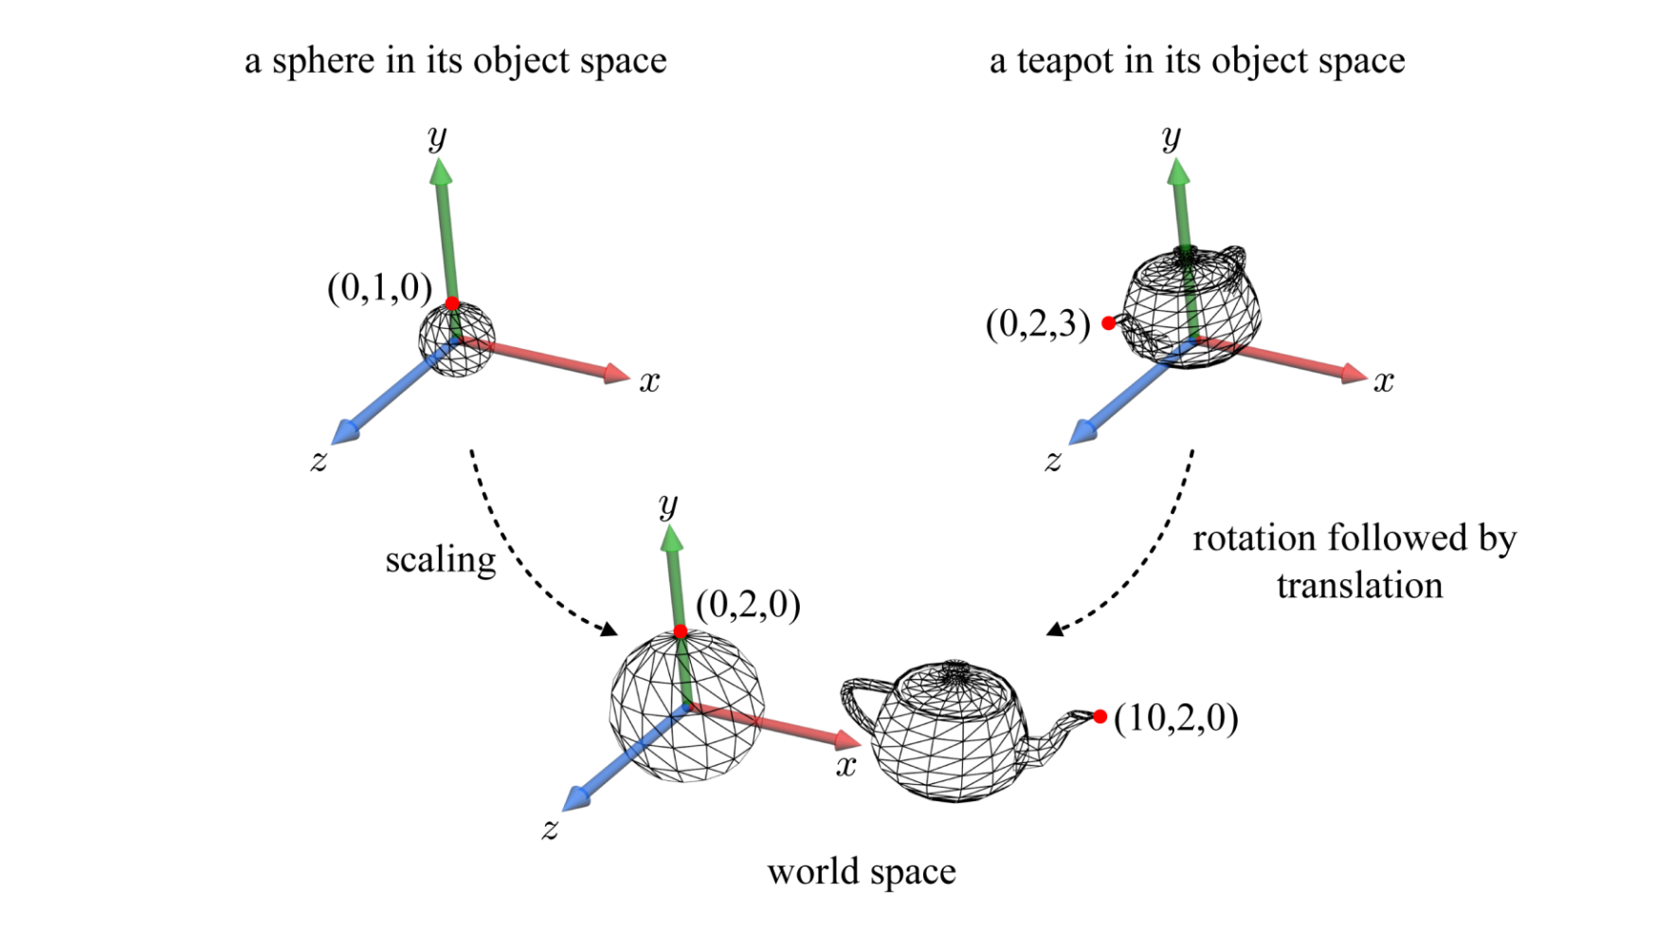
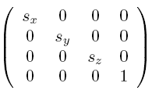
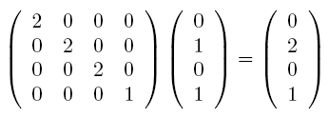
Application: World Transform
The coordinate system used for creating an object is named object space.
The object space for a model typically has no relationship to that of another model. The world transform ‘assembles’ all models into a single coordinate system called world space.
4-<number>

Slide 23
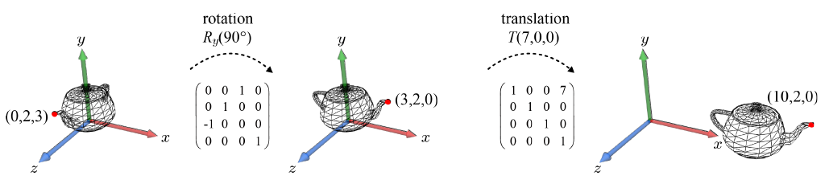
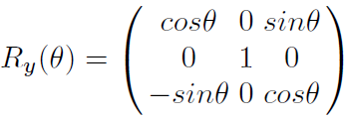
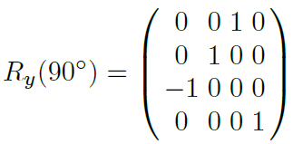
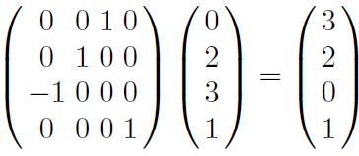
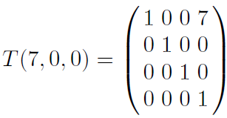
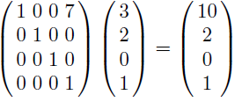
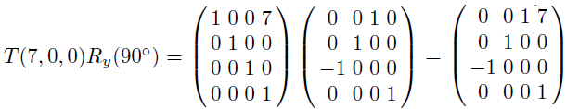
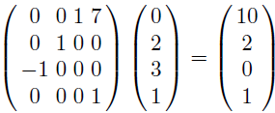
Application: World Transform (cont’d)
4-<number>

Slide 24
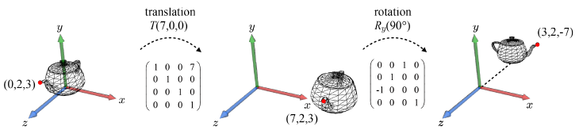
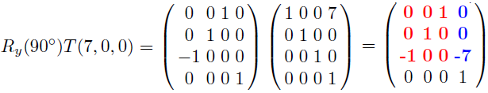
3D Affine Transforms
The discussions we had on 2D affine transforms apply to 3D affine transforms.
First of all, matrix multiplication is not commutative.
When 3D scaling, rotation, and translation matrices are concatenated to make a 4x4 matrix, the fourth row is always (0 0 0 1).
4-<number>

Slide 25
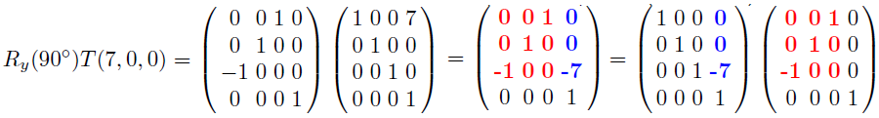
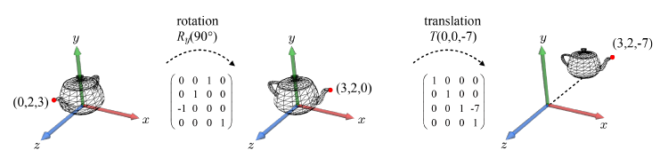
3D Affine Transforms (cont’d)
  Ignoring the fourth row of an affine matrix, we often denote the remaining 3x4 elements by [L|t], where L is a 3x3 matrix that represents a ‘combined’ linear transform, and t is a 3D column vector that represents a ‘combined’ translation.
  [L|t] is conceptually decomposed into two steps: L is applied first and then the linearly transformed object is translated by t.
4-<number>

Slide 26
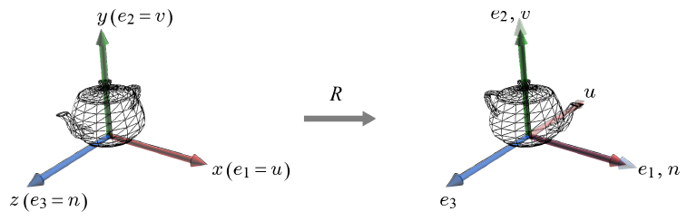
Rotation and Object-space Basis
Once an object is created, it is fixed within its object space. An object can be thought of as being stuck to its object space.
Initially the object space can be considered identical to the world space.
  The object-space basis is {u, v, n}.
  The world-space basis (standard basis) is {e₁, e₂, e₃}.
A rotation applied to an object changes its orientation, which can be described by the ‘rotated’ basis of the object space.
4-<number>

Slide 27
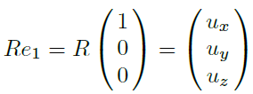
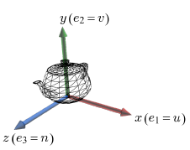
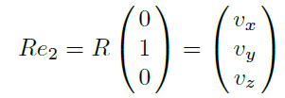
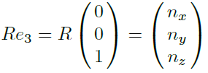

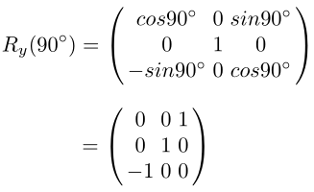
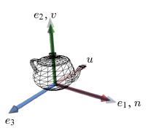
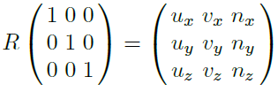
Rotation and Object-space Basis (cont’d)
By R, e₁ is rotated into u, and it is described as follows:
Similarly, R transforms e₂ and e₃ into v and n, respectively:
The above three are combined:
R’s columns are u, v, and n. Given the ‘rotated’ object-space basis, {u, v, n}, the rotation matrix is immediately determined, and vice versa.
u
v
n
4-<number>

Slide 28
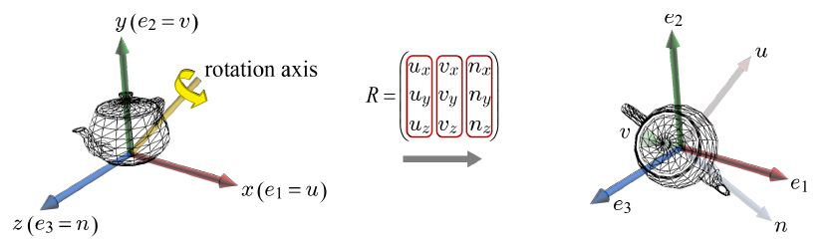
Rotation and Object-space Basis (cont’d)
The observation we have made holds in general.
4-<number>

Slide 29





Inverses of Translation and Scaling
Inverse translation
Inverse transform in inverse matrix
Inverse scaling
(d_{x}, d_{y}, d_{z})
(x+d_{x}, y+d_{y}, z+d_{z})
(x, y, z)
(-d_{x}, -d_{y}, -d_{z})
4-<number>

Slide 30

Inverse Rotation
Note that {u, v, n} is an orthonormal basis, i.e., u·u = v·v = n·n = 1 and u·v = v·n = n·u = 0.
Let’s multiply R’s transpose (R^{T}) with R:
This says that R⁻¹=R^{T}, i.e., the inverse of a rotation matrix is its transpose.
Because u, v, and n form the columns of R, they form the rows of R⁻¹.
4-<number>

Slide 31

Inverse Rotation (cont’d)
Recall that u, v, and n form the columns of R. As R⁻¹=R^{T}, u, v, and n form the rows of R⁻¹.
4-<number>

